Slide 1
Fish and Shellfish Classification using Deep Learning
Mitchell Krystofiak

Slide 2
Introduction
Researchers at UMCES and UMD have received funding from the USDA and NIFA to bring advances technologies to the domestic shellfish aquaculture industry.
These technologies include recent advances in the fields of robotics, agricultural automation, computer vision, sensing and imaging, artificial intelligence and high-performance computing.
As oyster and shellfish farming has expanded rapidly in the Chesapeake Bay region, applying these technologies to the industry will help meet the growing seafood demand worldwide.
Incorporating these advanced technologies would enhance the productivity and profitability of the industry while better protecting the fragile aquatic ecosystems.

Slide 3
Objectives
Build a Convolution Neural Network (CNN) capable of classifying different species of fish.
Use Keras Tuner to tune the parameters of the different layers of a CNN and to use Keras Callbacks to improve the training process and improve readability during training sessions.
Build a CNN capable of making a binary decision between a shellfish (oyster) and a fish.

Slide 4
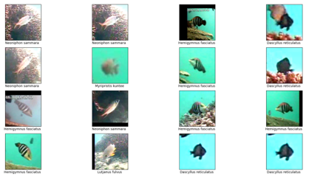
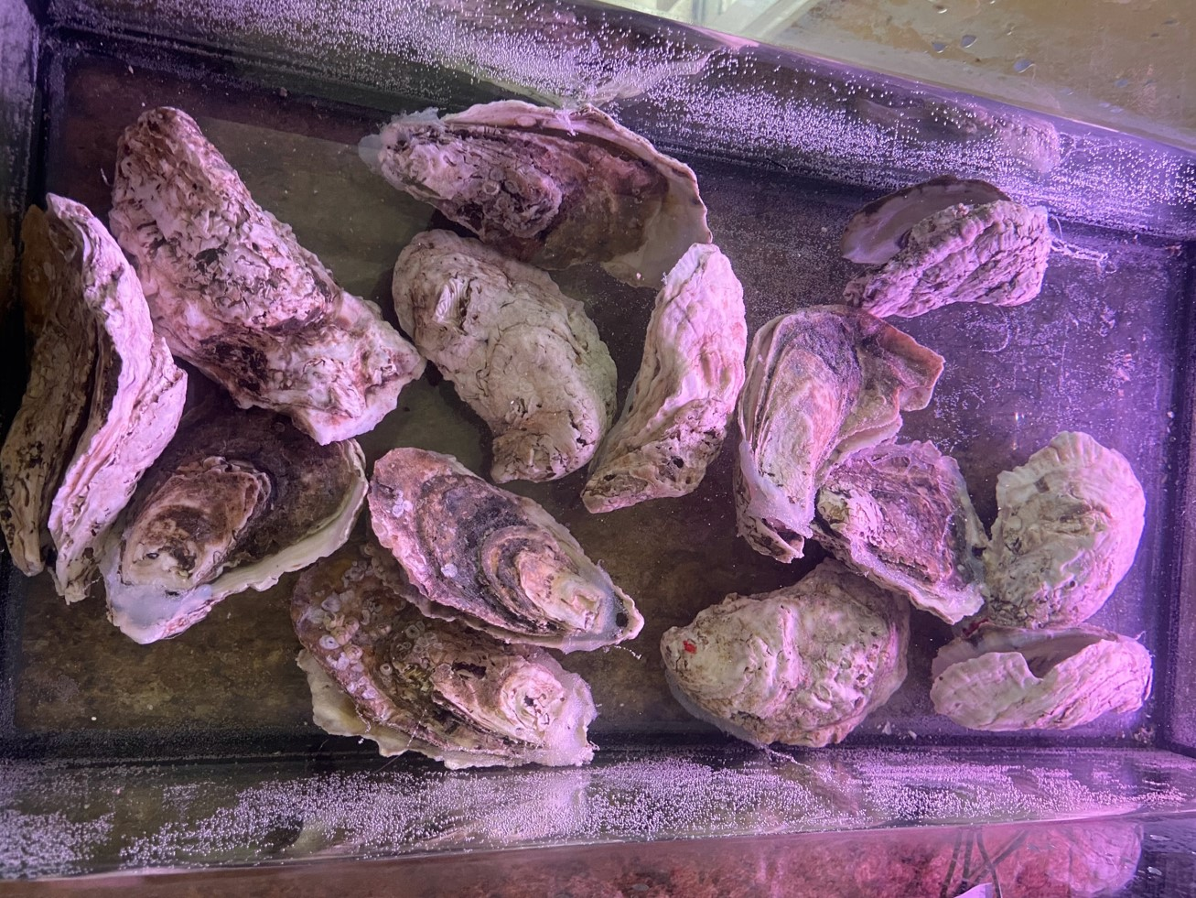
Experimental Details
Datasets – Fish4Knowledge and Oyster Images
Preprocessing using Image Data Generator and NumPy
Models built in Python3 using the TensorFlow and Keras libraries

Slide 5
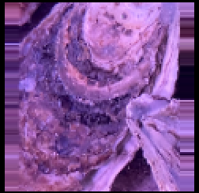
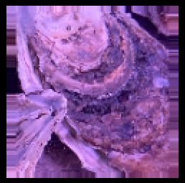
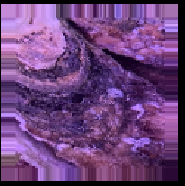
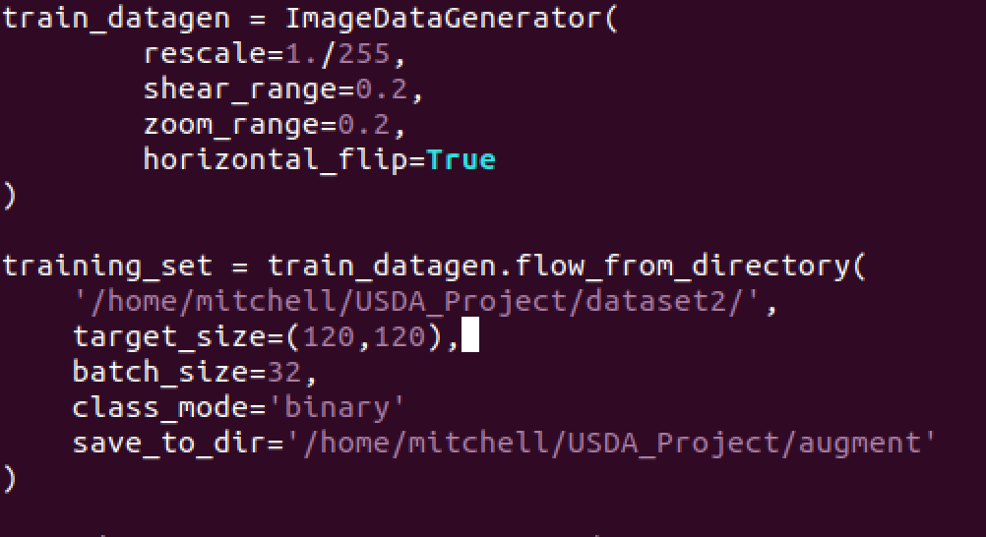
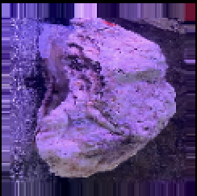
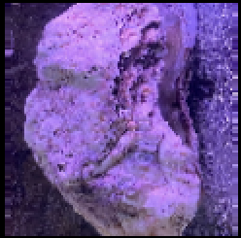
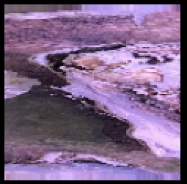
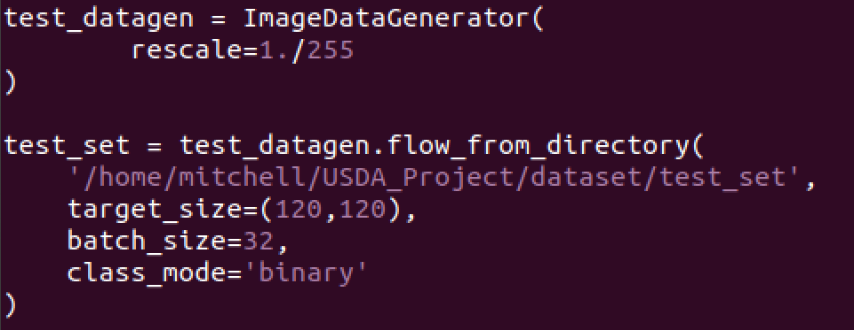
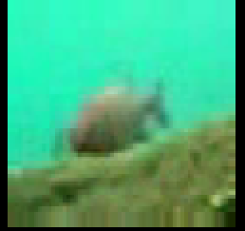
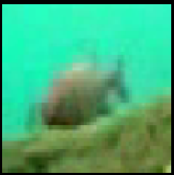
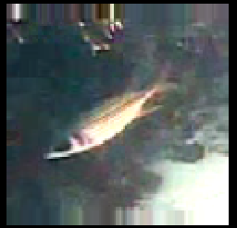
Experimental Details

Slide 6
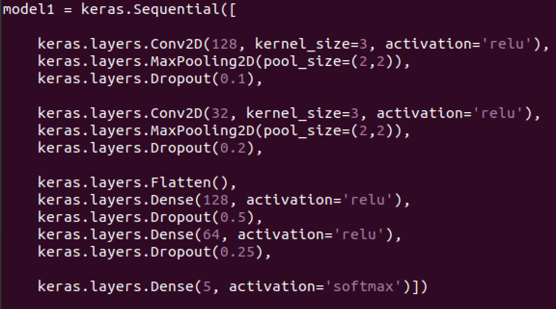
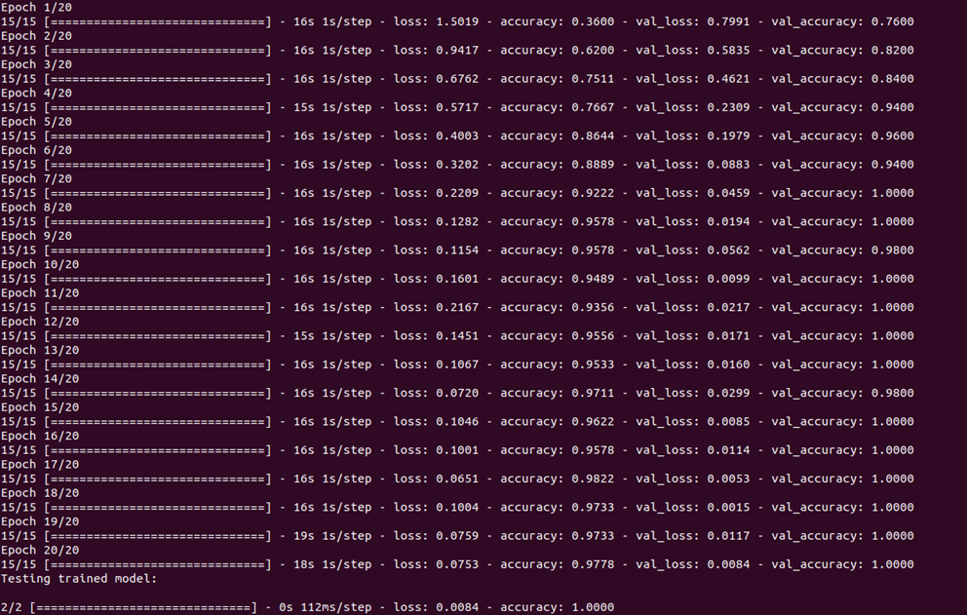
Results
The first model was built using Keras Tuner and Keras Callbacks.
Though the model was achieving high levels of accuracy, the validation set was performing better than the training set.

Slide 7
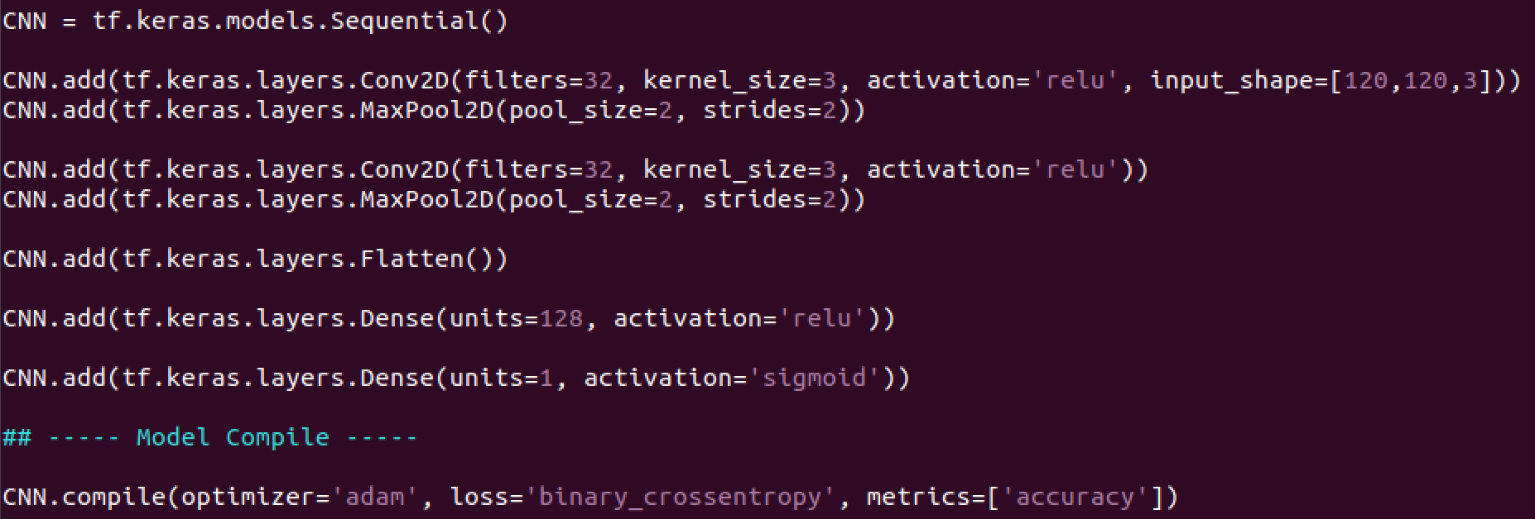
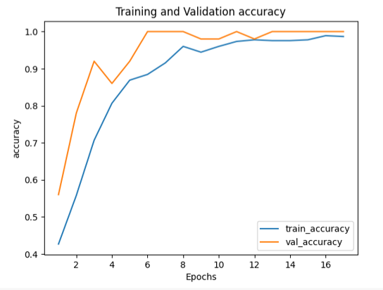
Results
The second model was built using a simple design to make a binary decision: fish or shellfish.
The model appeared to be learning incorrectly, possibly as a result of the varying images of oysters.

Slide 8
Conclusions
The validation set’s accuracy was higher than the training set’s accuracy. This is a clear indicator of overfitting.
Possible errors in the preprocessing stage that effect the models training process and in making the fish and oyster images the same size.
Need to explore k-fold cross validation techniques, used to un-bias the training and testing data. Also need to explore zero padding and interpolation, techniques used to alter the input images.

Slide 9
References
“Research team receives \$10M to transform shellfish farming with smart technology,” University of Maryland Center for Environmental Science, 29-Jun-2020. [Online]. Available: https://www.umces.edu/news/research-team-receives-10m-to-transform-shellfish-farming-with-smart-technology. [Accessed: 22-Jul-2021].
T. Riley, “Classification of Fish Species using a Convolution Neural Network,” May 2021.
D. Rathi, S. Jain, and S. Indu, “Underwater Fish Species Classification using Convolutional Neural Network and Deep Learning,” 2017 Ninth International Conference on Advances in Pattern Recognition (ICAPR), 2017.
C. Conol, “Hyperparameter Tuning with Keras Tuner,” Medium, 02-May-2020. [Online]. Available: https://towardsdatascience.com/hyperparameter-tuning-with-keras-tuner-283474fbfbe. [Accessed: 22-Jul-2021].
B. Chen, “A Practical Introduction to Keras Callbacks in TensorFlow 2,” Medium, 09-Oct-2020. [Online]. Available: https://towardsdatascience.com/a-practical-introduction-to-keras-callbacks-in-tensorflow-2-705d0c584966. [Accessed: 22-Jul-2021].
J. Brownlee, “A Gentle Introduction to k-fold Cross-Validation,” Machine Learning Mastery, 02-Aug-2020. [Online]. Available: https://machinelearningmastery.com/k-fold-cross-validation/. [Accessed: 22-Jul-2021].

